Slide 1
OLYMPIC DATA ANALYSIS PROJECT
BY : Anas Aamer
In this project, we walk you through an end-to-end project on creating a Power BI dashboard using Olympic data

Slide 2
CONTENTS
Question:1
01
Medals won by Gender %
02
Question:2
Male and females participants Ratio by Year
03
Question:3
Top 10 countries by medals
04
Question:4
Top Olympic Medalist by total number
05
Question:5
Total number of participants countries
05
Question:6
Total number of sports

Slide 3
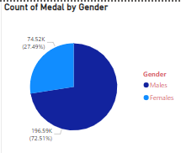
OLYMPIC DATA ANALYSIS PROJECT
01
Question:1
Medals won by Gender %

Slide 4
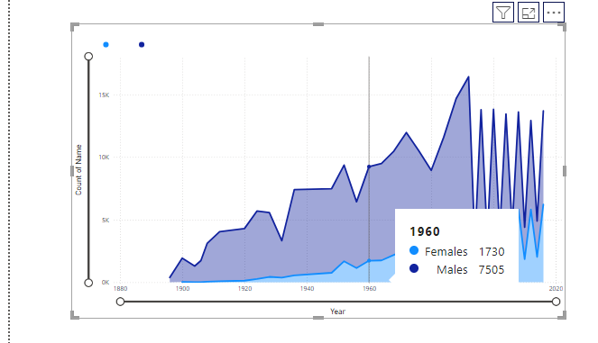
OLYMPIC DATA ANALYSIS PROJECT
02
Question:2
Male and females participants Ratio by Year

Slide 5
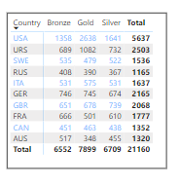
OLYMPIC DATA ANALYSIS PROJECT
03
Question:3
Top 10 countries by medals

Slide 6
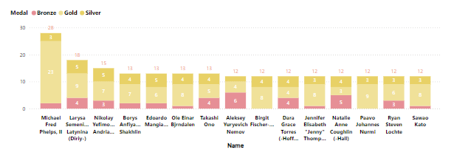
OLYMPIC DATA ANALYSIS PROJECT
04
Question:4
Top Olympic Medalist by total number

Slide 7
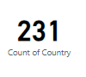
OLYMPIC DATA ANALYSIS PROJECT
05
Question:5
Total number of participants countries

Slide 8
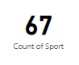
OLYMPIC DATA ANALYSIS PROJECT
05
Question:6
Total number of sports

Slide 9
THANK YOU

